Slide 1
ANALYSIS : OFFICE SUPPLY DATASET

Slide 2
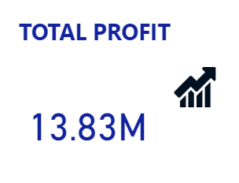
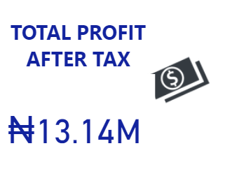
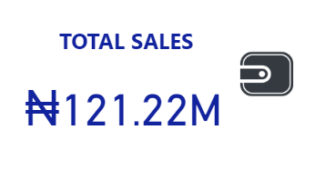


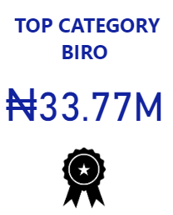
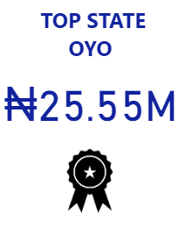
EXECUTIVE SUMMARY Mission To provide a diverse selection of products to office environments on a business-to-business basis, making each aspect of every transaction a positive and satisfying experience. Vision We are the company of choice recognized by our employees for our core values and opportunities for personal and professional growth. We are the preeminent independent supplier of choice recognized by our customers as the best in total satisfaction and value.

Slide 3
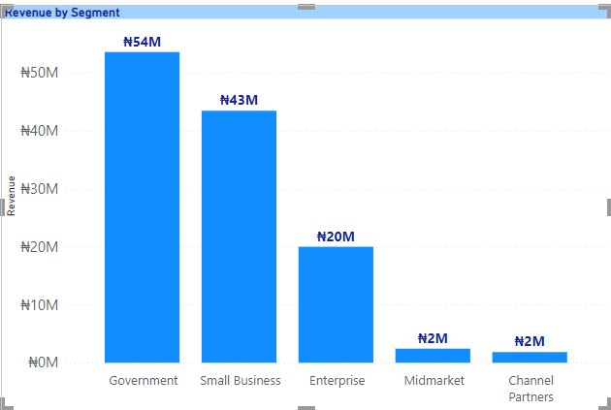
Government having the most revenue generated within the focus period Channel Partner having the least contribution to revenue of just 1.51% with N2M
Key insights:

Slide 4
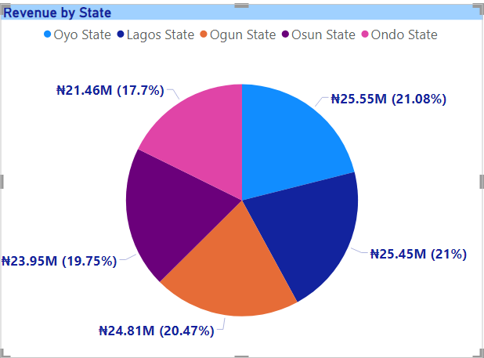
Across all five segments, revenue ranged from Oyo State to the least, Ondo state Ondo State generated the least revenue of 21.46M due to the long strike experienced during the focus year
Key insights:

Slide 5
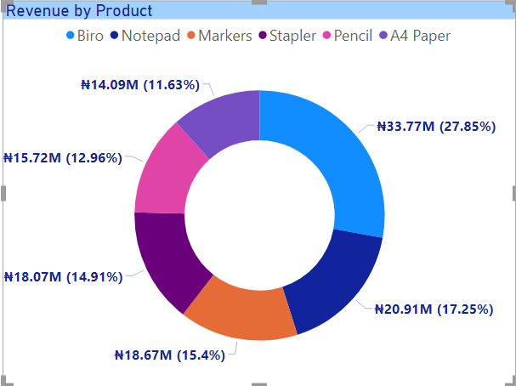
A4 paper accounted for a low 11.63% of total income generated whereas Biros made a rather significant impact to the total revenue generated. A4 Paper made the least contribution due to the increased cost of printing machinery which had a spiral effect on purchase of A4 Paper
Key insights:

Slide 6
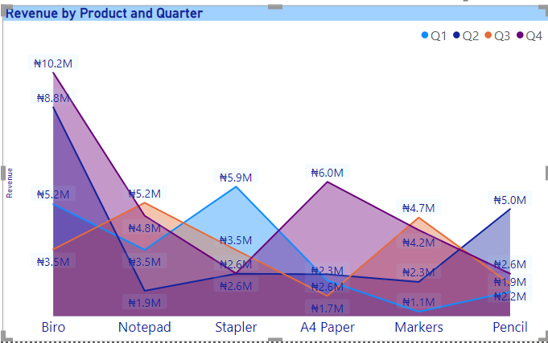
In course of Q1, Staplers made the most revenue with 5.9M, which is 4.8M more than revenue generated by Markers. Q2 featured Biros as the most retailed product In Q3, Notepad revenue increased to 5.2M, Markers also made a significant impact in revenue with 4.7M In Q4, Biro remained the leading product with 10.2M in proceeds while Pencils and staplers were tied at 2.6M
Key insights:

Slide 7
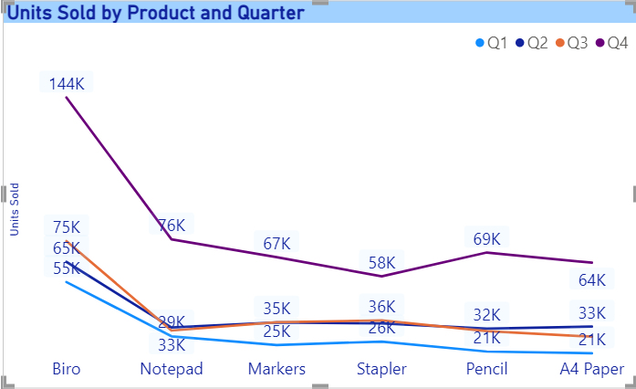
Q1 saw a low number of sales with Biros retailing the most with 55k units while Pencil and A4 Paper tied on 21k Q2 saw a slight increase in unit sold across board with Biros still leading the race with 65k units sold Q3 saw a slight decrease for Notepads, same with Pencils Q4 made a huge sale of Biros with other Products selling a lot more units compared to previous quarters
Key insights:

Slide 8
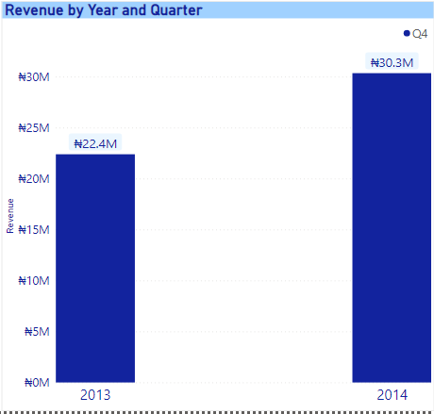
The year 2013 in Q4 made significantly less revenue compared to 2014.
Key insights:

Slide 9
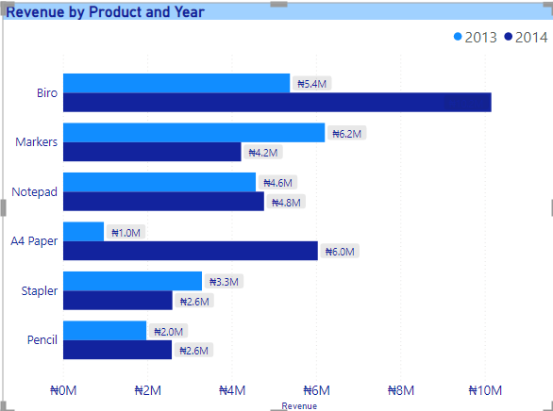
There was a huge difference in sales of A4 Paper between 2013 and 2014. Biros made the most sales in 2014 compared to any other Product Markers and Staplers had a decline in Sales from 2013 to 2014
Key insights:

Slide 10
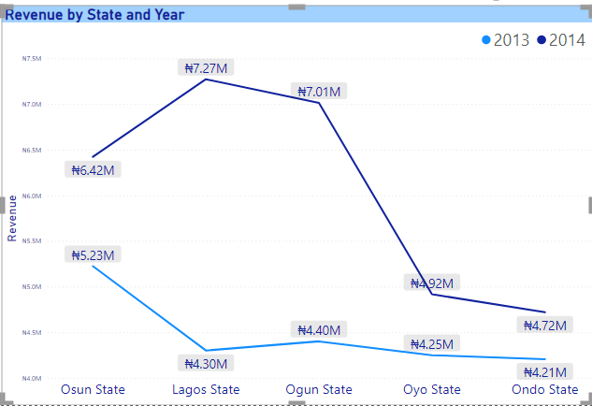
In 2014, Lagos State followed by Ogun State generated more revenue with Ondo State as the least generating. Overall, the year 2014 fared much better than 2013
Key insights:

Slide 11
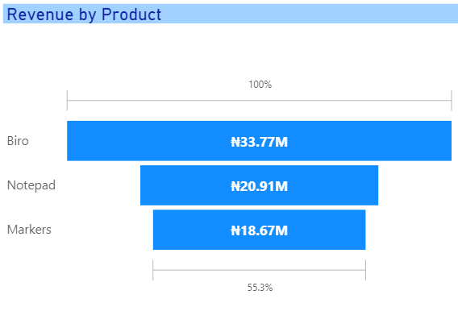
Key Products that drive Performance Biros, Notepads and Markers are the top products and key drivers of Performance

Slide 12
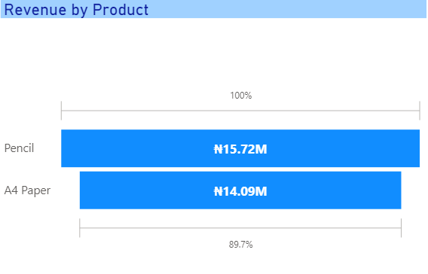
Pencils and A4 Paper are the two products that can be discontinued due to poor performances.

Slide 13
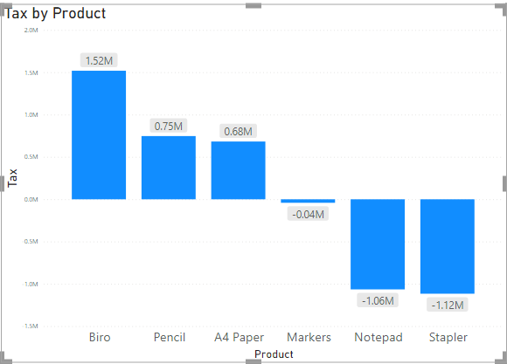
Staplers were the least taxed product while Biros was the most taxed product with 1.52M in tax
Key insights:

Slide 14
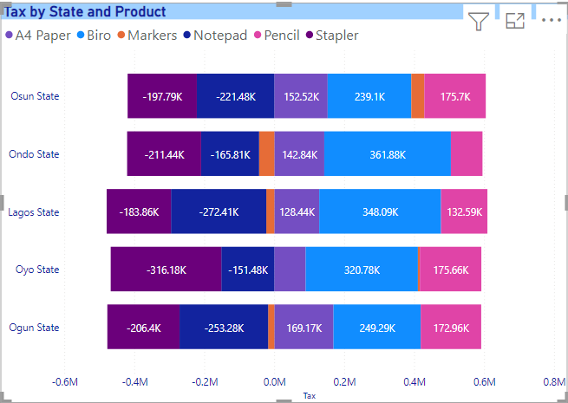
In Osun State, Notepad was the least taxed while Biros was the most taxed. In Ondo State, Biros was the most taxed and Staplers least taxed. In Lagos State, Notepad was least taxed while Biros was most taxed with 348.09K. In Oyo State, Staplers was least taxed while Biros was most taxed. In Ogun State, Biros was most taxed with Notepad the least taxed.
Key insights:

Slide 15
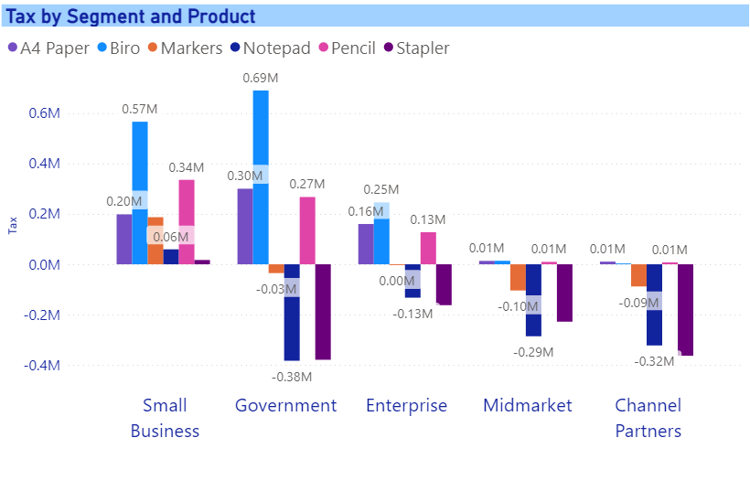
For each segment, Biros was the most taxed with Staplers the least taxed The overall most taxed segment is the small businesses while the least taxed segment are the Channel Partners The Government segment recorded the most taxed(Biro) and least taxed Product (Notepad)
Key insights:

Slide 16
Recommendations and Conclusion
Increase customer targets (number of states and segments where products are supplied to) in order to grow revenue
Increasing the discount on A4 Paper in order to boost sales
Improve branding of Pencils to increase revenue generation
Improve customer relationship to take advantage of the increasing market share for the next year
Reducing Bottlenecks in sales process to help attract and increase follow up for indecisive customers
Overall, revenue generated in the last few years were within error margin. However, with the recommendations provided, there is room for improvement and analysis suggests that Management is on the right track

